Slide 1
Logical Clocks & Synchronization

Slide 2
Learning Objectives
State the role and importance of synchronization and logical clocks in distributed systems.
Describe methods that are used to achieve clock synchronization in distributed systems.
Discuss the importance of synchronized clocks in distributed systems and some examples of algorithms that have been used to achieve synchronization.
Describe the use of timestamps in various multicasting protocols and their conceptual implementation.
Notes:
Students may not know exactly what is meant by globalization or may have an incomplete understanding of the term. You might ask students what they think it means. Potential answers could include: reduction of economic and cultural advantages of developed countries, increased number of companies with operations in multiple countries worldwide, and increased reliance on imports and exports of goods (and jobs). Globalization will be discussed in later slides as well.

Slide 3
Motivation
Synchronization is important if we want to:
  control access to a single, shared resource
  agree on the ordering of events.
Synchronization in Distributed Systems is much more difficult than in uniprocessor systems.
We will consider:
  Synchronization based on “Actual Time”.
  Synchronization based on “Relative Time”.
Notes:
Synchronization ----
Situation in which two or more processes coordinate their activities based on a condition.

Slide 4
Lack of Global Time in DS
It is impossible to guarantee that physical clocks run at the same frequency.
Lack of global time can cause problems.
Example: UNIX make
  Edit output.c at a client
  output.o is at a server (compile at server)
  Client machine clock can be lagging behind the server machine clock.

Slide 5
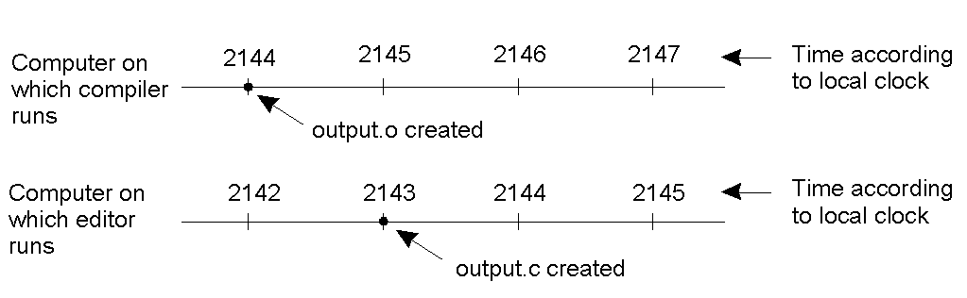
Lack of Global Time – Example…
Figure 1-1: Global Time
When each machine has its own clock, an event that occurred after another event may nevertheless be assigned an earlier time.

Slide 6
A Note on Real Time
Universal Coordinated Time (UTC): basis of all modern civil timekeeping.
Radio stations can broadcast UTC for receivers to collect it
External: synchronize with an external resource, UTC source
Internal: synchronize without access to an external resource.
Notes:
Coordinated Universal Time (UTC) is the primary time standard by which the world regulates clocks and time. It has essentially replaced the old standard, Greenwich Mean Time.
WWV is the call sign of the United States National Institute of Standards and Technology's (NIST) HF ("shortwave") radio station in Fort Collins, Colorado.

Slide 7
Cristian’s Algorithm – External Synch
External source S
Denote clock value at process X by C(X)
Periodically, a process P:
  send message to S, requesting time
  Receive message from S, containing time C(S)
  Adjust C at P, should we set C(P) = C(S)?
Reply takes time.
When P adjusts C(P) to C(S), C(S) > C(P)!!!

Slide 8
Cristian’s Algorithm – External Synch…
B
T₃
T₂
A
T₁
T₄
Figure 1-2: Time Offset
Dilemma: How to estimate machine A’s time offset relative to B?

Slide 9
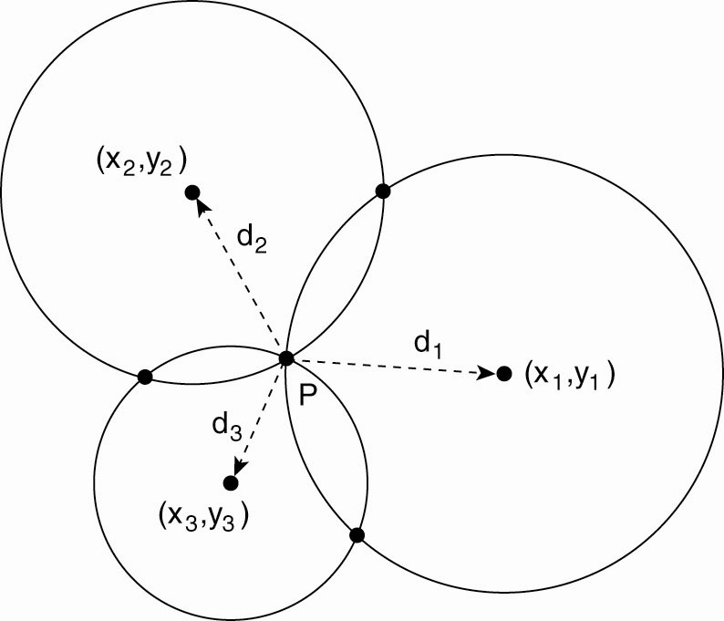
Global Positioning System (GPS)
Computing a position in a two-dimensional space.
Figure 1-3: GPS

Slide 10
Berkeley Algorithm – Internal Synch
Internal: synchronize without access to an external resource;
|C_{i}(t) – C_{j}(t)| < D
Periodically,
S: send C(S) to each client P
P: calculate δ_{P} = C(P) – C(S)
send δ_{P} to S
S: receive all δ_{P}’s
compute an average Δ
send Δ-δ_{P} to client P
P: apply Δ-δ_{P} to C(P)

Slide 11
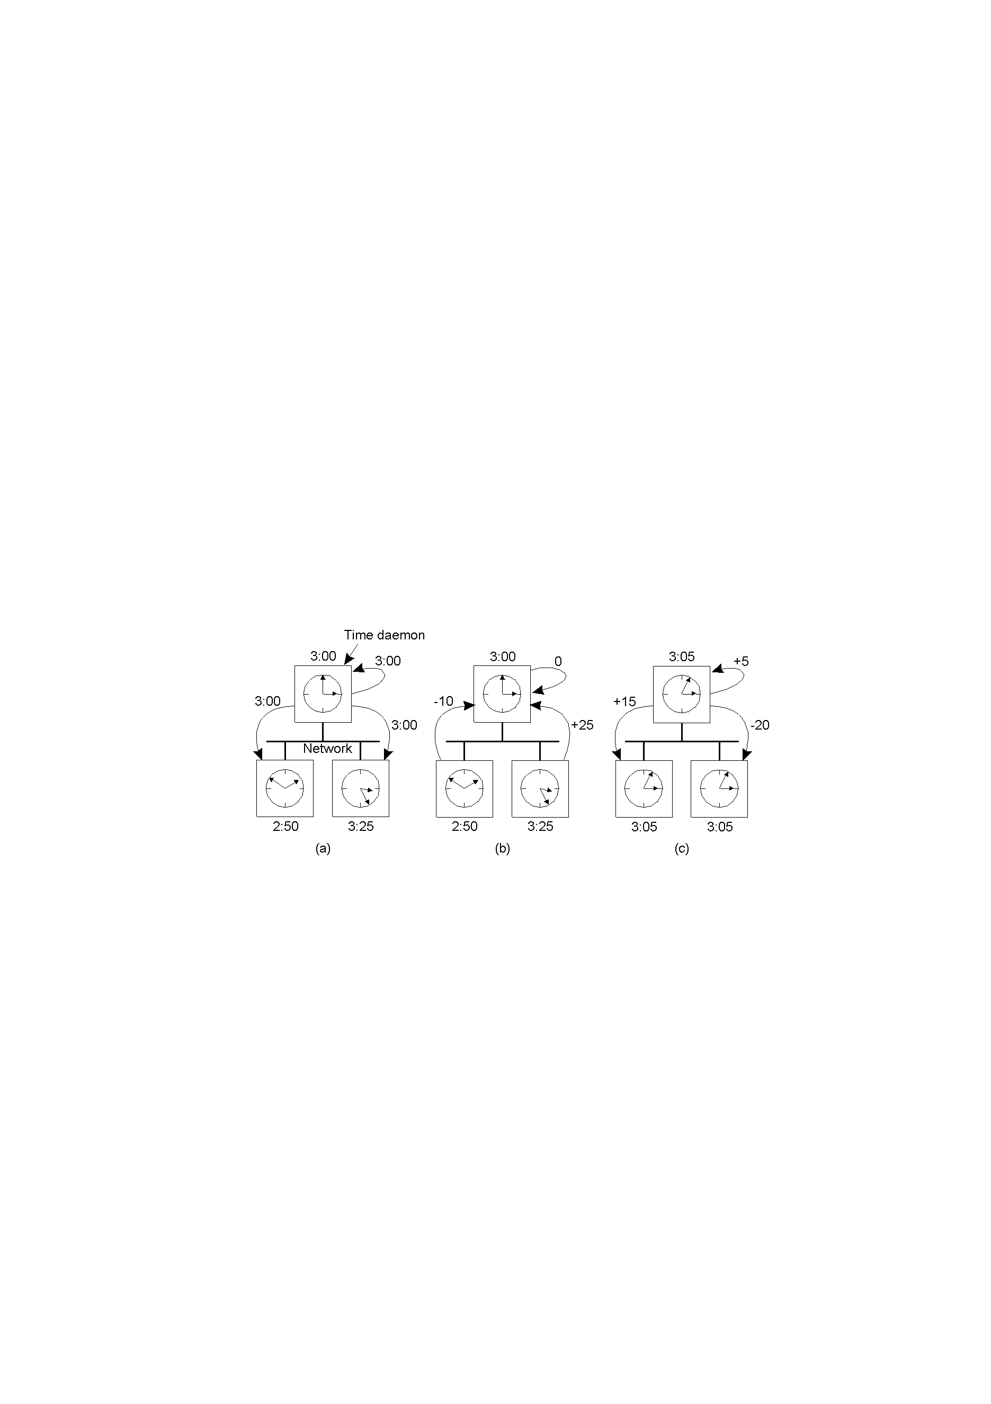
The Berkeley Algorithm
Figure 1-4: Berkeley Algorithm
The time daemon asks all the other machines for their clock values
The machines answer
The time daemon tells everyone how to adjust their clock
Propagation time?
Time server fails?

Slide 12
Importance of Synchronized Clocks
New H/W and S/W for synchronizing clocks is easily available.
Nowadays, it is possible to keep millions of clocks synchronized to within few milliseconds of UTC.
New algorithms can benefit.

Slide 13
Event Ordering in Centralized Systems
A process makes a kernel call to get the time.
Process which tries to get the time later will always get a higher (or equal) time value.
  ⇒ no ambiguity in the order of events and their time.

Slide 14
Logical Clocks
For many DS algorithms, associating an event to an absolute real time is not essential, we only need to know an unambiguous order of events
    Lamport's timestamps
    Vector timestamps

Slide 15
Logical Clocks…
Synchronization based on “relative time”.
“relative time” may not relate to the “real time”.
What’s important is that the processes in the Distributed System agree on the ordering in which certain events occur.
Such “clocks” are referred to as Logical Clocks.

Slide 16
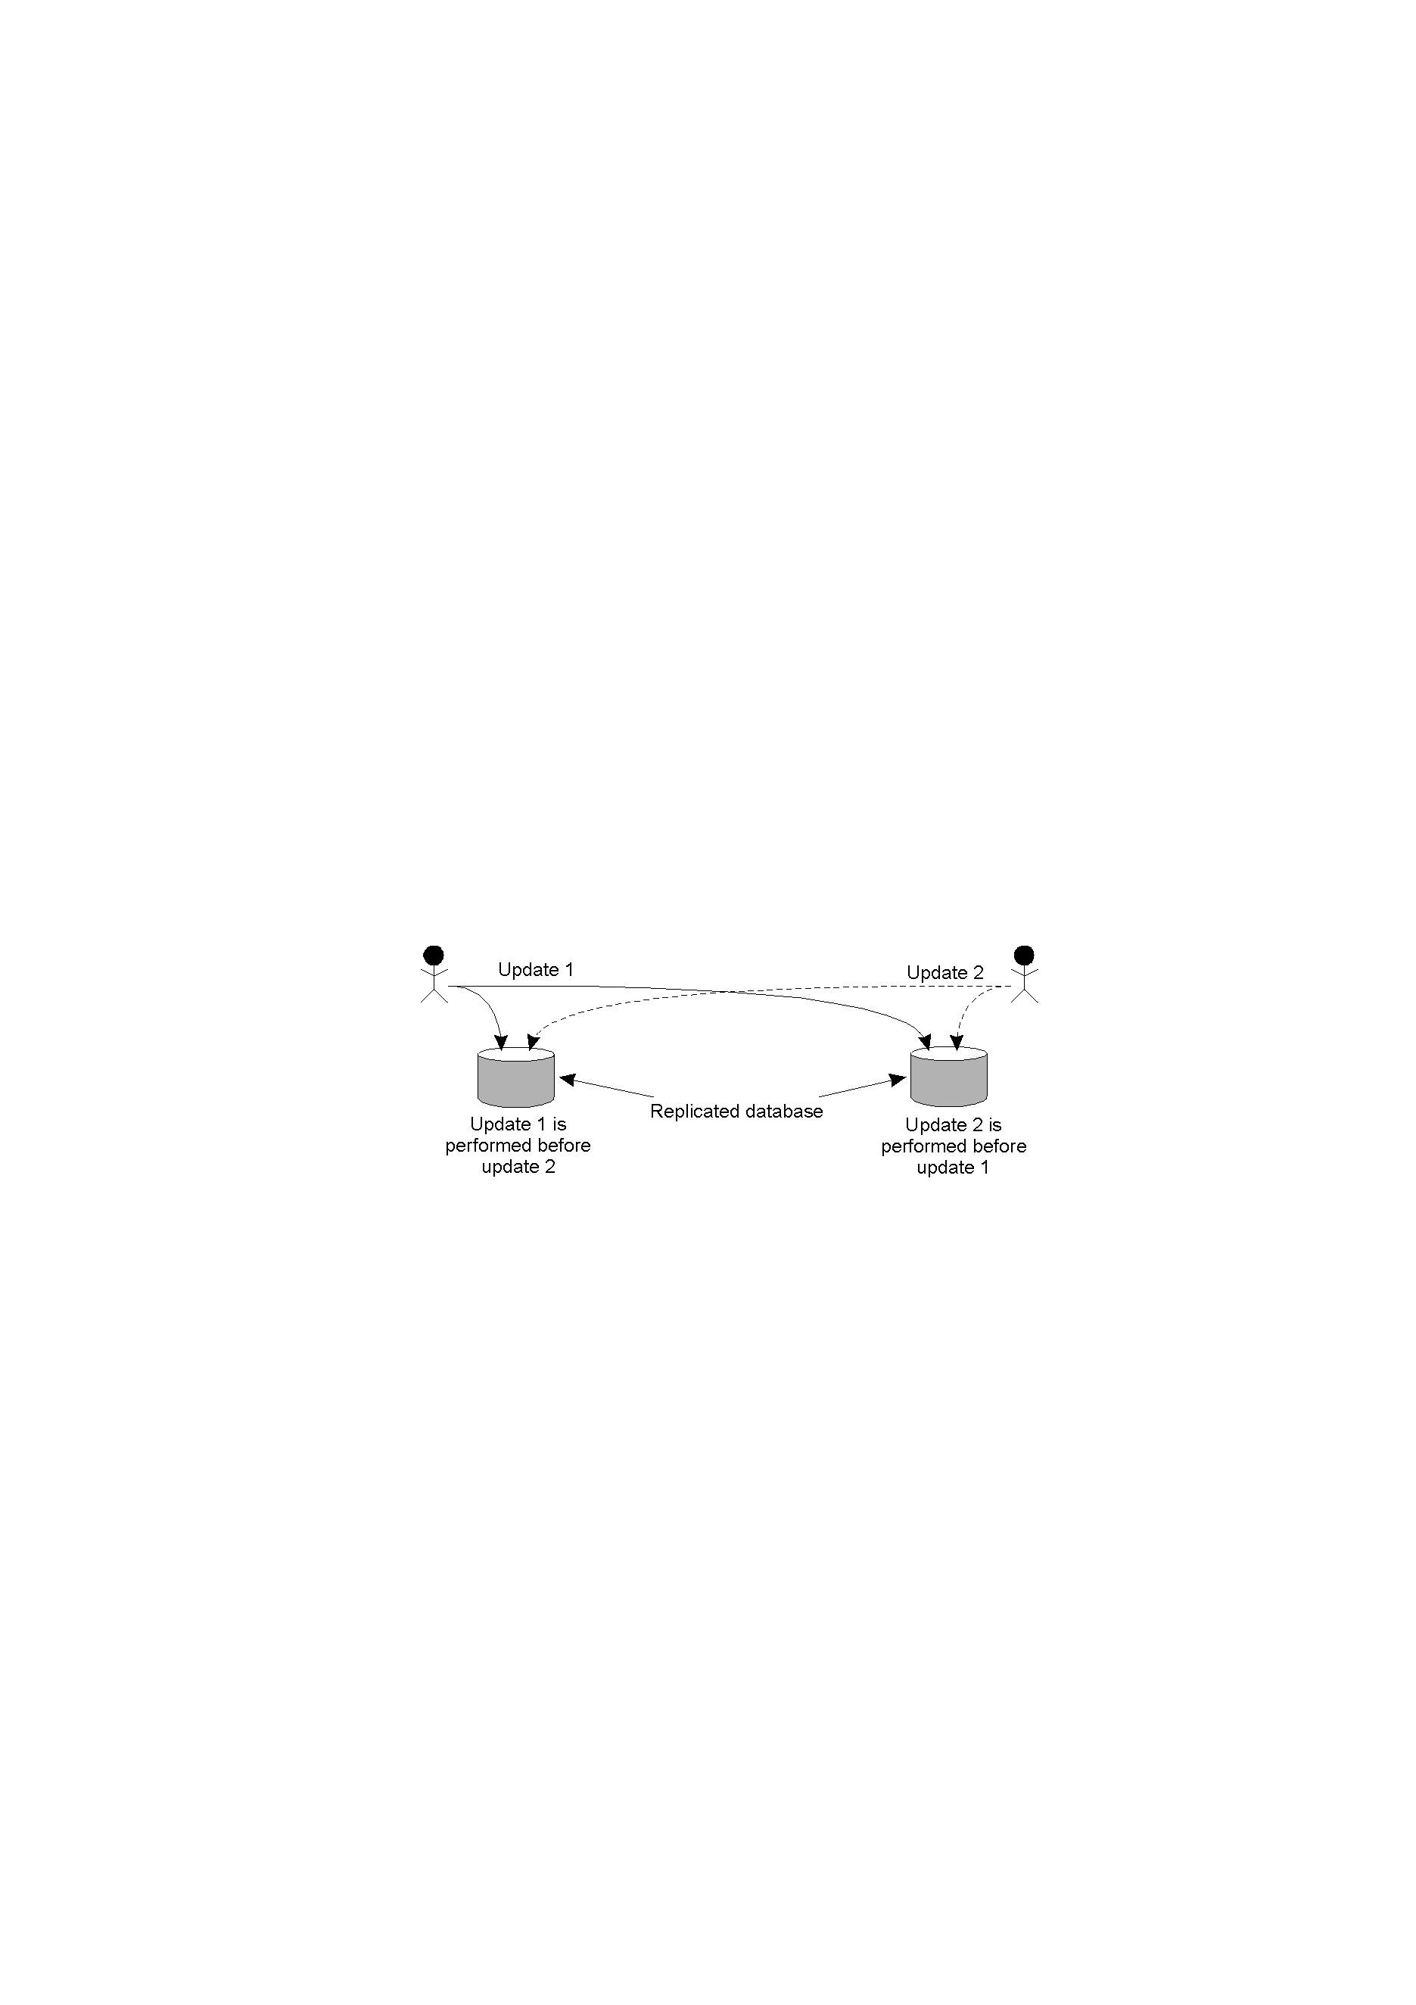
Example: Why Order Matters…
Figure 1-5: Event Ordering
  Replicated accounts in New York (NY) and San Francisco (SF)
  Two updates occur at the same time
    Current balance: $1,000
    Update1: Add $100 at SF; Update2: Add interest of 1% at NY
    Whoops, inconsistent states!

Slide 17
Lamport’s Algorithm
Premise: Clock synchronization does not have to be exact;
  Synchronization not needed if there is no interaction between machines.
  Synchronization only needed when machines communicate
  Machines must only agree on ordering of interacting events.

Slide 18
Lamport’s “Happens-Before” Partial Order…
Given two events e & e’, e < e’ if:
Same process: e <_{i} e’, for some process P_{i}
Same message: e = send(m) and e’=receive(m) for some message m
Transitivity: there is an event e* such that e < e* and e* < e’.
Transitive Law: if A bears some relation to B and B bears the same relation to C, then A bears it to C. E.g. if Bob is taller than Tom and Tom is taller than Alice, it naturally implies that Bob is taller than Alice.

Slide 19
Concurrent Events…
Given two events e & e’:
If neither e < e’ nor e’< e, then e || e’
Real Time
a
b
P₁
m₁
c
d
P₂
m₂
e
f
P₃
Figure 1-6: Concurrent Events
Notes:
Note that if two events happen without any message, then we can't say anything about their relative occurrence in time.
In this example a <= b <= c <= d <= f, but we can say little about e other than e <= f. We say that events such as a and e are concurrent.
Note also that “happens before” does not demonstrate causality. There is merely the potential for causality.

Slide 20
Lamport’s Logical Clocks…
Substitute synchronized clocks with a Global ordering of events
  e_{i} < e_{j} ⇒ LC(e_{i}) < LC(e_{j})
  LC_{i} is a local clock: contains increasing values
    each process i has own LC_{i}
  Increment LC_{i} on each event occurrence
  within same process i, if e_{j} occurs before e_{k}
    LC_{i}(e_{j}) < LC_{i}(e_{k})
  If e_{s} is a send event and e_{r} receives that send, then
    LC_{i}(e_{s}) < LC_{j}(e_{r})

Slide 21
Lamport’s Algorithm…
Each process increments local clock between any two successive events.
Message contains a timestamp.
Upon receiving a message, if received timestamp is ahead, receiver fast forwards its clock to be one more than sending time.

Slide 22
Lamport’s Algorithm…
Timestamp;
  Each event is given a timestamp t
  If e_{s} is a send message m from p_{i}, then t=LC_{i}(e_{s})
  When p_{j} receives m, set LC_{j} value as follows;
    If t < LC_{j}, increment LC_{j} by one
      Message regarded as next event on j
    If t ≥ LC_{j}, set LC_{j} to t+1

Slide 23
Total Ordering of Events
“Happens-Before” is only a partial order
Make the timestamp of an event e of process P_{i} be:
(LC(e),i)
(a,b) < (c,d) iff a < c, or a = c and b < d

Slide 24
Application: Total-Order Multicasting
  Message is timestamped with sender’s logical time
  Message is multicast (including sender itself)
  When message is received
    It is put into local queue
    Ordered according to timestamp
    Multicast acknowledgement
  Message is delivered to applications only when
    It is at head of queue
    It has been acknowledged by all involved processes

Slide 25
Application: Total-Order Multicasting
Figure 1-7: Total-Order Multicasting
Update 1 is time-stamped and multicast. Added to local queues.
Update 2 is time-stamped and multicast. Added to local queues.
Acknowledgements for Update 2 sent/received. Update 2 can now be processed.
Acknowledgements for Update 1 sent/received. Update 1 can now be processed.
(Note: all queues are the same, as the timestamps have been used to ensure the “happens-before” relation holds.)

Slide 26
Limitation of Lamport’s Algorithm
e_{i} < e_{j} ⇒ LC(e_{i}) < LC(e_{j})
However, LC(e_{i}) < LC(e_{j}) does not imply e_{i} < e_{j}
  for instance, (1,1) < (1,3), but events a and e are concurrent.
a
b
Real Time
P₁
(1,1)
(2,1)
m₁
c
d
P₂
(3,2)
(4,2)
m₂
e
g
f
P₃
(1,3)
(2,3)
(5,3)
Figure 1-8: Lamport’s Algorithm

Slide 27
Vector Timestamps
P_{i}’s clock is a vector VT_{i}[]
VT_{i}[i] = number of events P_{i} has timestamped
VT_{i}[j] = what P_{i} thinks number of events P_{j} has stamped (i ≠ j)

Slide 28
Vector Timestamps…
Initialization
  the vector timestamp for each process P is initialized to (0,0,…,0)
Local event
  when an event occurs on process P_{i}, VT_{i}[i] ← VT_{i}[i] + 1
    e.g. on processor 3, (1,2,1,3) → (1,2,2,3)

Slide 29
Vector Timestamps…
Message passing
  when P_{i} sends a message to P_{j}, the message has timestamp t[]=VT_{i}[]
  when P_{j} receives the message, it sets VT_{j}[k] to max (VT_{j}[k],t[k]), for k = 1, 2, …, N
    e.g. P₂ receives a message with timestamp (3,2,4) and P₂’s timestamp is (3,4,3), then P₂ adjusts its timestamp to (3,4,4)

Slide 30
Comparing Vectors…
VT₁ = VT₂ iff VT₁[i] = VT₂[i] for all i
VT₁ ≤ VT₂ iff VT₁[i] ≤ VT₂[i] for all i
VT₁ < VT₂ iff VT₁ ≤ VT₂ & VT₁ ≠ VT₂
  for instance, (1, 2, 2) < (1, 3, 2)

Slide 31
Application: Causally-Ordered Multicasting
For ordered delivery of related messages;
  V_{i}[i] is only incremented when sending
  When k gets a msg from j, with timestamp ts, the msg is buffered until:
    1: ts[j] = V_{k}[j] + 1
      (timestamp indicates this is the next msg that k is expecting from j)
    2: ts[i] ≤ V_{k}[i] for all i ≠ j
      (k has seen all msgs that were seen by j when j sent the msg)

Slide 32
Causally-Ordered Multicasting
P2
[0,0,0]
P1
[0,0,0]
P3
[0,0,0]
Post a
[1,0,0]
a
[1,0,0]
e
[1,0,0]
c
r: Reply a
[1,0,1]
d
g
b
[1,0,1]
[1,0,1]
Two messages:
message a from P1;
message r from P3 replying to message a;
Scenario1: at P2, message a arrives before the reply r

Slide 33
Causally-Ordered Multicasting…
P2
[0,0,0]
P1
[0,0,0]
P3
[0,0,0]
Post a
[1,0,0]
a
d
[1,0,0]
g
[1,0,1]
r: Reply a
Buffered
b
[1,0,1]
c
[1,0,0]
Deliver r
Scenario2: at P2, message a arrives after the reply r.
The reply is not delivered right away.

Slide 34
Ordered Communication
Totally ordered multicast
  Uses Lamport’s timestamps
Causally ordered multicast
  Uses Vector timestamps

Slide 35
Summary
Synchronization is important if we want to;
  control access to a single, shared resource
  agree on the ordering of events.
Synchronization in Distributed Systems;
  much more difficult than in uniprocessor systems.
To achieve ordered Communication;
  Total-order multicast uses Lamport’s Timestamps »
  Causally-ordered multicast uses Vector Timestamps »

Slide 36
Recommended Reading…
http://web.stanford.edu/class/cs240/readings/lamport.pdf
http://groups.csail.mit.edu/tds/papers/Fan/FanLynch-gradient.pdf
http://pap.ais.uni-kassel.de/CoMMVE09/papers/commve-weis.pdf

Slide 37
Next……
Distributed Lookup Services & DHTs
Group Project Discussions
Assessed Lab Exercise II

